Slide 1

Omaha – Lincoln
Nebraska Chapter
July 21, 2025

Slide 2

NETWORKING!
Mon, July 21, 5:30 – 6:05 PM CST
Please signed in
In-Person: Sign-in Sheet
Virtual: Announce your entry and exit
You will receive an email confirming your attendance
You will need to self-report CPEs
Food provided by Proofpoint

Slide 3
July 21, 2025 Agenda
* Approx times All Times CDT
5:30pm
Network, Sign-in
6:00pm
Zoom Start
6:05pm
Chapter Business
6:20pm
Guest Speaker – James Naylon, Strategic Account Manager, Proofpoint
7:20pm
Wrap-up (informal networking)

Slide 4
Chapter Business

Slide 5
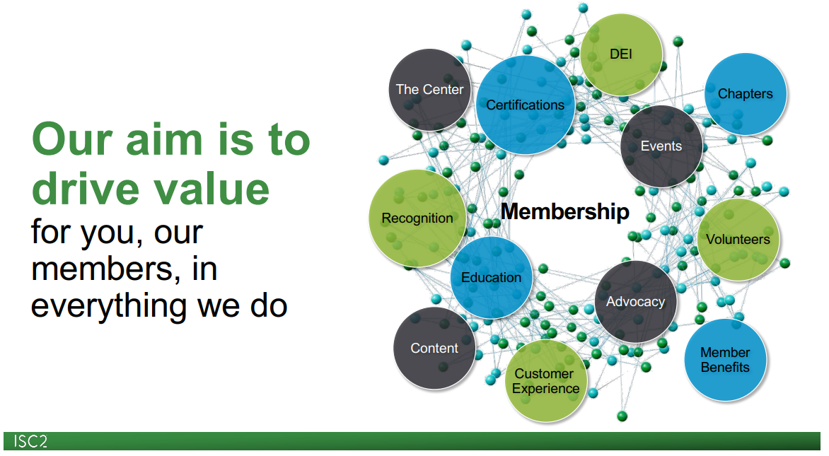
https://www.brighttalk.com/resource/core/484480/new-member-onboarding-webinar_march-2025_1030682.pdf

Slide 6
ISC2 Omaha-Lincoln Chapter Board
New 2026 board members
Needed!
President: Bruce Wray
Board members:
Ron Woerner, Vice President
Patty Ellington, Secretary
Robert Copley / Roy Gertig, Treasurer
Greg Bradley, Membership
Joe Kannas, Member at Large

Slide 7
Pillars of Chapter Strategy
The strategy is organized into three pillars that contain a series of projects strengthening connections between ISC2 and chapters.
Sustainability
Vitality
Impact
ISC2 supports chapters to deliver a high quality, consistent member experience
ISC2 provides tools and support structures to help chapters and chapter members flourish
ISC2 and chapters collaborate to amplify their impact in local cybersecurity ecosystems
Notes:
At the Q4 2024 meeting, the Board of Directors approved the chapter strategy pursuant to the Board’s direction for closer affiliation between ISC2 and chapters. Affiliation means a closer connection, strengthening ISC2’s ability to guide chapter activity without sacrificing chapter autonomy.
We envisage a future where:
Cybersecurity professionals value ISC2 chapter membership for professional development, networking and community.
Chapters play a leading role in coordinating volunteer activity and develop a pipeline of future leaders.
Chapters amplify the impact of ISC2 strategic initiatives.
Chapter leaders can be ambassadors for ISC2 and the profession.
The strategy is organized into three pillars which contain a series of projects strengthening connections between ISC2 and chapters.
Sustainability - we want to provide a platform for chapters to fulfil ISC2’s mission while managing the risks to all parties.
We also believe that chapter members should have a consistent experience.
The proposed initiatives reflect the fact that the best knowledge on good practice and technology lies with chapter leaders.
That providing ‘preferred’ tools delivering core functionality can substantially improve chapter management.
We also believe legal registration is essential, as it facilitates revenue collection and succession, while mitigating risk.
Finally, that direct funding should be dispersed equitably to support chapters at times of need.
Vitality - In our strategy, we want chapter members and leaders, from new and established chapters, to flourish. We believe an organisation that is not growing is dying, and so growth is an important measure of vitality.
Investment in member management will provide better data, reporting, and facilitate the exchange of data between ISC2 and chapters. This unlocks potential for chapter and ISC2 member growth. It also reduces the administrative burden on chapter leaders, letting them focus on developing themselves and their members, through robust mentoring programs.
Management committees will make most enterprising volunteer leaders responsible for the development of chapters in their region. Create a pipeline of future volunteer leaders, and a scalable support model leveraging volunteers and ISC2 staff.
Impact - We recognise that performant chapters and their leaders can amplify the impact of strategic initiatives. They can mobilize volunteer involvement, and strengthen ISC2’s influence and network, particularly in international markets. This is true for ISC2 and the Center. Eventually, we want to fund and incentivize chapter involvement in center and ISC2 objectives. But this can only occur when more chapters are on a sustainable footing, to avoid continually investing the same chapters, or funding chapters that can’t be relied upon to follow through.
Finally our aim to enhance partnerships reflects the fact that chapters nowadays are less likely to operate in a vacuum, but form part of a network of organisations active locally. These ecosystems not only help to create and sustain communities, they also advance industrial and public policy. Collaboration with chapters and local third parties allows ISC2 to show up as more than a certification body. In practice this could mean strengthening links between academia and industry, or connecting cyber professionals with local volunteering opportunities.

Slide 8
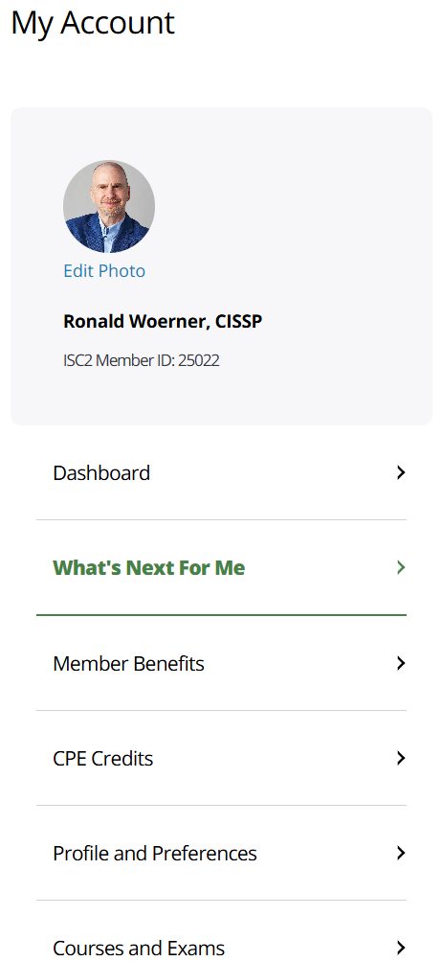
ISC2 Dashboard (NEW)
Dashboard Link (Need to have an ISC2 login)
Video introduction: https://youtu.be/lX69YG4ICz8?si=gKZIZ2ZE0Id7qLQf
What’s Next For Me
Certifications and Courses
ISC2 Insights – The latest updates, along with member views on global cybersecurity trends and issues, public policy, technology innovation and more.
Additional Resources – Connect globally, engage locally to build door-opening relationships.

Slide 9

ISC2 Up2Date: July 16th, 2025
ISC2’s AI Month: New research reveals the extent of AI cybersecurity tools adoption and its impact on training and recruitment, a sneak peek at what’s coming up at ISC2 Security Congress, members look at the impact AI is having on their organizations, plus new AI courses and certificate launch.
ISC2 Survey: 30% of Cyber Pros Using AI Security Tools
AI adoption is impacting both organizational operations and the workforce; the cybersecurity industry is no exception. ISC2 surveyed global cybersecurity professionals to better understand this impact. Read the report
https://www.linkedin.com/newsletters/isc2-up2date-7234222484202389506/

Slide 10
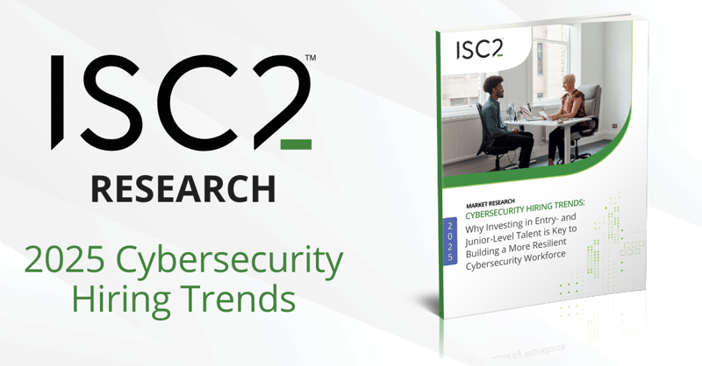
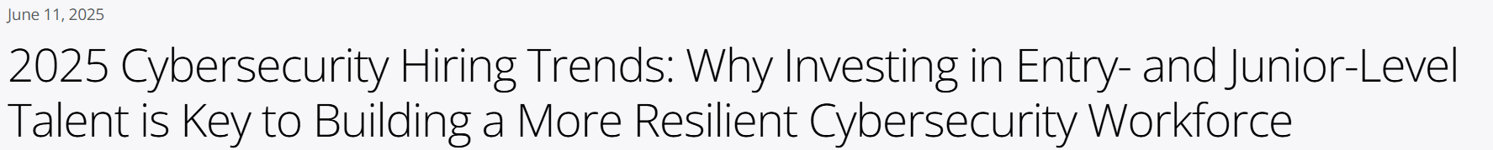
ISC2 Annual Cybersecurity Workforce Study
This annual study is shared with government agencies, referenced in countless media reports and used by organizations of all sizes around the world as a benchmark for security hiring strategies. Help shape the conversation and build awareness for the issues that matter most to cybersecurity professionals like you.
Please note this survey may take up to 30 minutes.
All members who complete the survey and provide a valid Member ID will be awarded 0.5 CPE. Please allow up to 8 weeks for the CPE credit to be allocated to your account. ISC2 has retained SG Analytics, an independent international research firm, to host this survey.
https://www.isc2.org/Insights/2025/06/cybersecurity-hiring-trends-study

Slide 11
September 2025 Chapter Meeting
Mark
Your
Calendars!
Date: Monday, September 15
Time: 5:30 PM – 7:30 PM CDT
Topic: Surviving A Security Firestorm, Being Prepared for Your Next Incident
Event registration information will be sent by email and posted on our website and LinkedIn group.

Slide 12


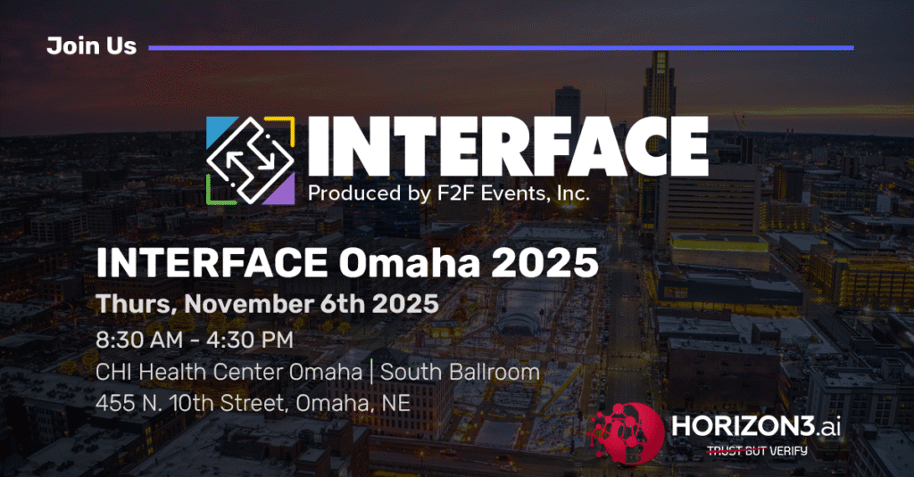
Upcoming Cybersecurity Events
Mark
Your
Calendars!
https://web.cvent.com/event/00885cdc-a7ef-4682-81d1-77950c2f3d07/websitePage:e3e1427f-5c48-423a-a0e5-60dcec1c4363
Omaha Cybersecurity Conference, Thursday, August 14, 2025, DoubleTree by Hilton Hotel Omaha Downtown
Our chapter's promo code is ISC2OL and is valid for an unlimited number of free in-person passes that adhere to our registration guidelines.
https://futureconevents.com/events/omaha-ne-2025/
https://horizon3.ai/event/interface-omaha-2025/

Slide 13
ISC2 Omaha-Lincoln Chapter Marketing
Email: isc2omahalincoln@gmail.com
Website: https://isc2omaha.org/
LinkedIn: https://www.linkedin.com/groups/4266535/
Rebuilding the Chapter mailing list* * We will not sell or give away the mailing list
PLEASE HELP spread the word about the chapter!
Best

Slide 14
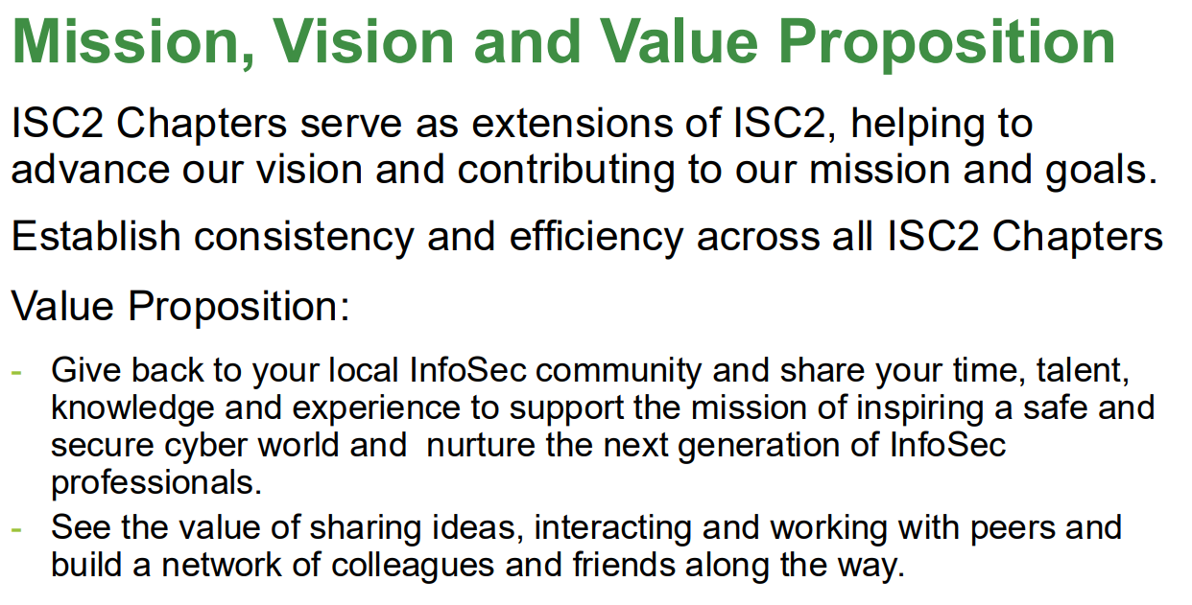

Slide 15
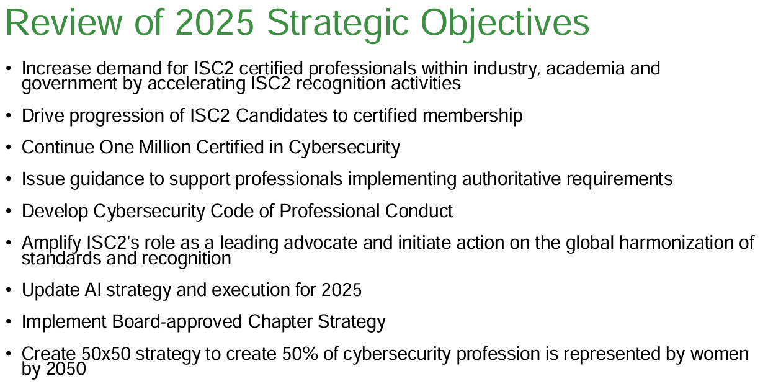

Slide 16
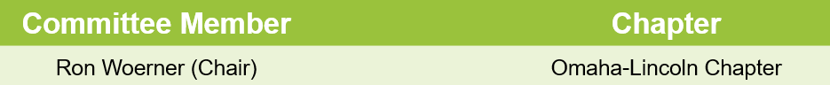
Chapter Regional Management Committees (CMRC) Chapters – Central/Midwest Sub-Region
Alberta
Manitoba
Saskatchewan
Arkansas
Panhandle
Quad Cities
Chicago
Kansas City
Wichita
Central Gulf Coast
Greater Detroit
West Michigan
Twin Cities
St Louis-Scott AFB
Central Mississippi
Omaha-Lincoln
Central Ohio
Cincinnati Tri-State
Cleveland
Tulsa Metro
Oklahoma City Metro
Alamo
Austin
Dallas Ft. Worth
Houston
Permian Basin

Slide 17
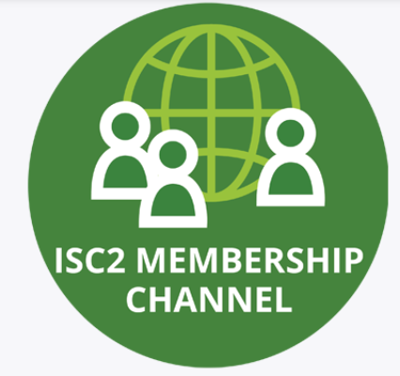
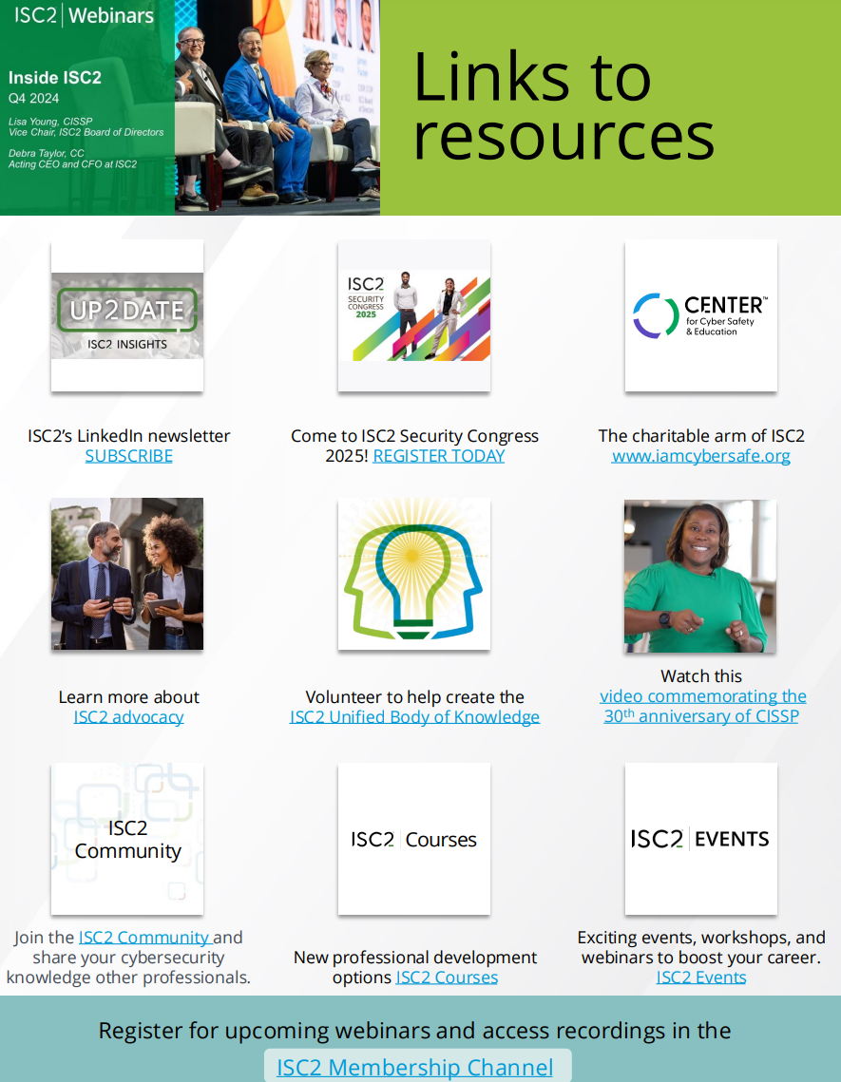
ISC2 Membership Page Link
https://www.isc2.org/professional-development/webinars/membership
https://www.brighttalk.com/resource/core/478885/121724-q4-2024-inside-isc2-links-to-resources_1018129.pdf

Slide 18
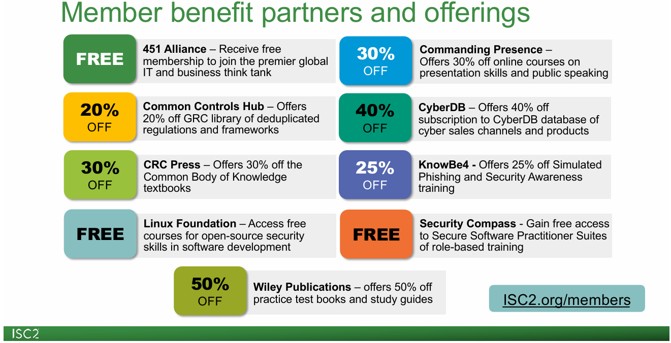

Slide 19
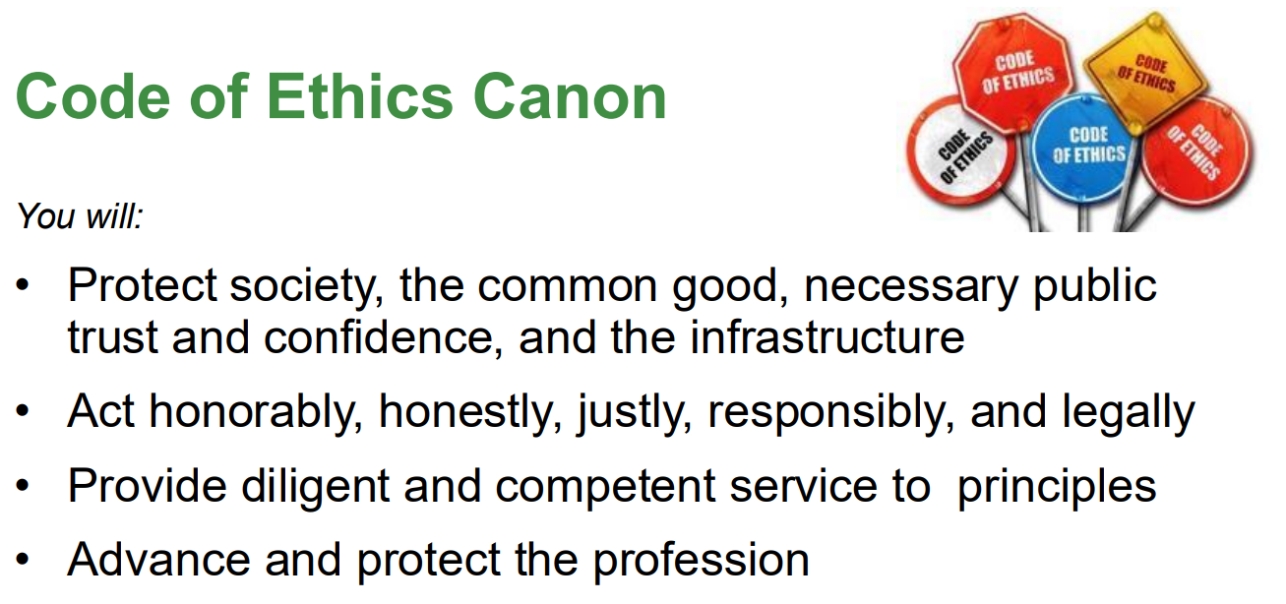
https://www.isc2.org/ethics

Slide 20
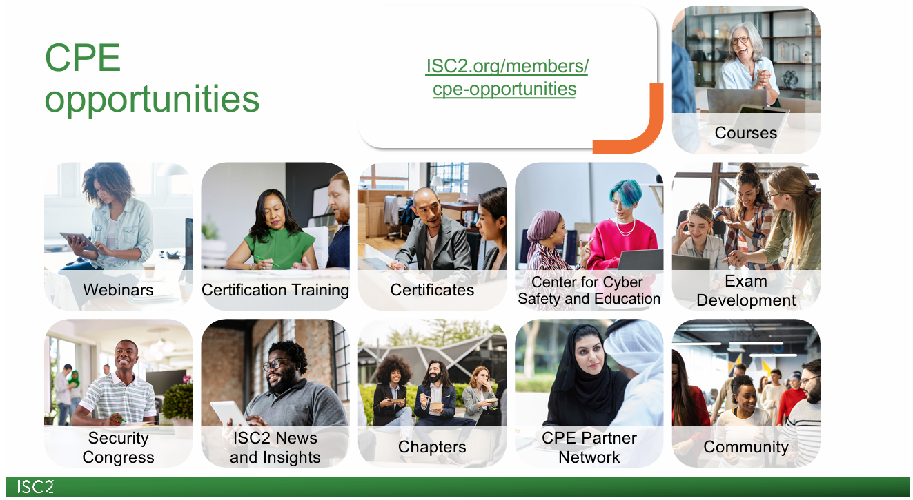

Slide 21
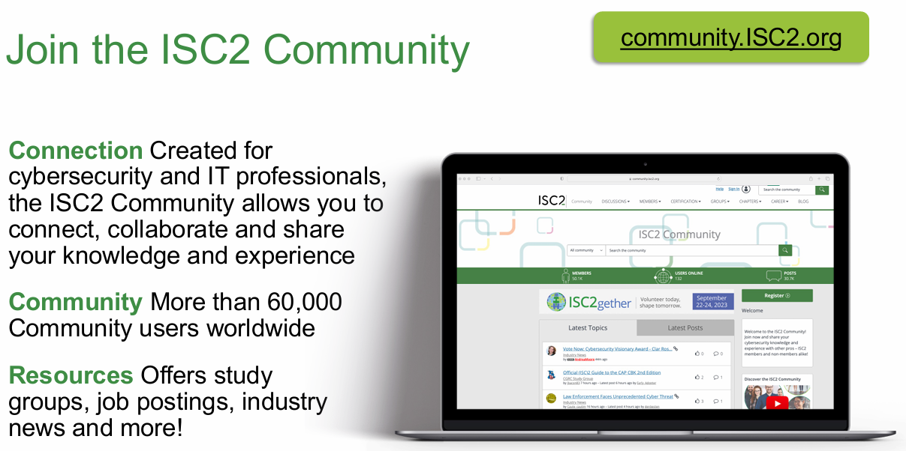

Slide 22

ISC2 Resources
CISSP General Information https://www.isc2.org/certifications/cissp
CISSP Certification Exam Outline https://www.isc2.org/Certifications/cissp/Certification-Exam-Outline
CISSP Experience Requirements https://www.isc2.org/Certifications/CISSP/experience-requirements
ISC2 CPE Credits & Activities https://www.isc2.org/Insights/2024/05/Managing-Your-ISC2-CPE-Credits-and-Activities
ISC2 Certification References https://www.isc2.org/certifications/References

Slide 23

Q&A

Slide 24
Networking!

Slide 25

Thank you!
Be Safe
See you next time!

